Slide 1





AI-Based Smart Saving & Expense Management System
Team : Team_12430
Arshan Rangrej J.
Kuldeep Parmar
Shreya Shinde D.
Vanshika Lakhtariya H.
Nagma Khatoon Shaikh I.
Under the mentorship of,
Palwinder Singh
Notes:
Slide Duration: 5 min
Objective: To get an insight about Design Thinking
Procedure:
Explanation:
Introduce the topic "Design Thinking"
Design thinking is a creative approach to problem-solving that puts people at the center.
It starts with understanding the needs of those who will use what you're designing.
Then, it involves brainstorming ideas, prototyping solutions, and testing them to see what works best.
It's about being open-minded, collaborative, and willing to try new things to come up with innovative solutions that really fit people's needs.
Learning outcome: Students will be introduced to the topic Design Thinking.

Slide 2


Project Objectives
Improve financial awareness
Develop AI-powered expense tracker
Provide personalized saving advice
Add daily expenses
View expense summaries
Get AI-based saving suggestions
Track monthly savings goals
Source
https://www.freepik.com/
Notes:
Slide duration: 5 min
Objective: To know the content of the lesson.
Procedure:
Tell students what they are going to learn today.
Discuss each topics given in the slide.
Learning Outcome: Students will get to know the content of today's lesson.

Slide 3
Problem Statement
Financial management is a major challenge for students due to limited income sources and a lack of structured budgeting tools. Most students rely on monthly allowances, scholarships, or part-time earnings, which require careful planning and monitoring. However, in the absence of intelligent financial systems, students often fail to track their expenses effectively.
Existing expense tracking applications primarily focus on recording transactions but do not provide predictive analysis or personalized financial guidance. They lack the ability to analyze spending patterns, detect overspending behavior, or forecast future expenses. This results in poor budgeting decisions, reduced savings, and increased financial stress.
Notes:
Total duration: 5mins
Learning Objective: In this slide, the trainer will explain the students what they will learn and be able to apply in the real life situations.
Procedure: Discuss the above as the outcome of the session
Learning outcome: Students will understand the learning outcome in this slide.

Slide 4
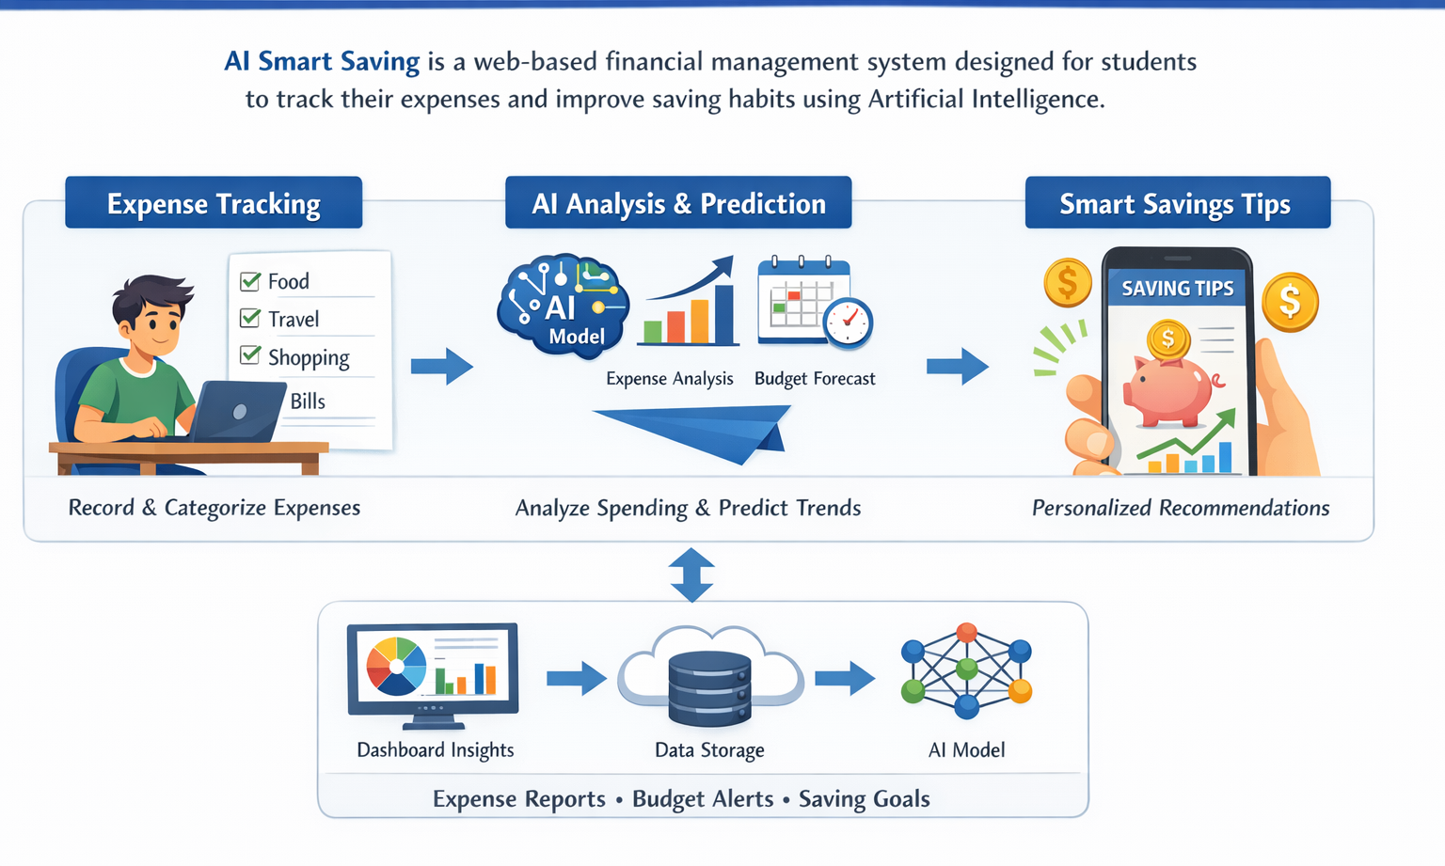
Project overview - Introduction
AI Smart Saving is a web-based financial management system designed specifically for students to track their daily expenses and improve their saving habits. The system allows users to record expenses under different categories and monitor their monthly spending in a structured manner.
Notes:
Total duration: 5mins
Learning Objective: In this slide, the trainer will explain the students what they will learn and be able to apply in the real life situations.
Procedure: Discuss the above as the outcome of the session
Learning outcome: Students will understand the learning outcome in this slide.

Slide 5
End User
College Students
Hostel Students
Scholarship Students
Notes:
Total duration: 5mins
Learning Objective: In this slide, the trainer will explain the students what they will learn and be able to apply in the real life situations.
Procedure: Discuss the above as the outcome of the session
Learning outcome: Students will understand the learning outcome in this slide.

Slide 6
Wow factor
AI-based prediction
Smart saving suggestions
Personalized insights
Real-time alerts
Notes:
Total duration: 5mins
Learning Objective: In this slide, the trainer will explain the students what they will learn and be able to apply in the real life situations.
Procedure: Discuss the above as the outcome of the session
Learning outcome: Students will understand the learning outcome in this slide.

Slide 7
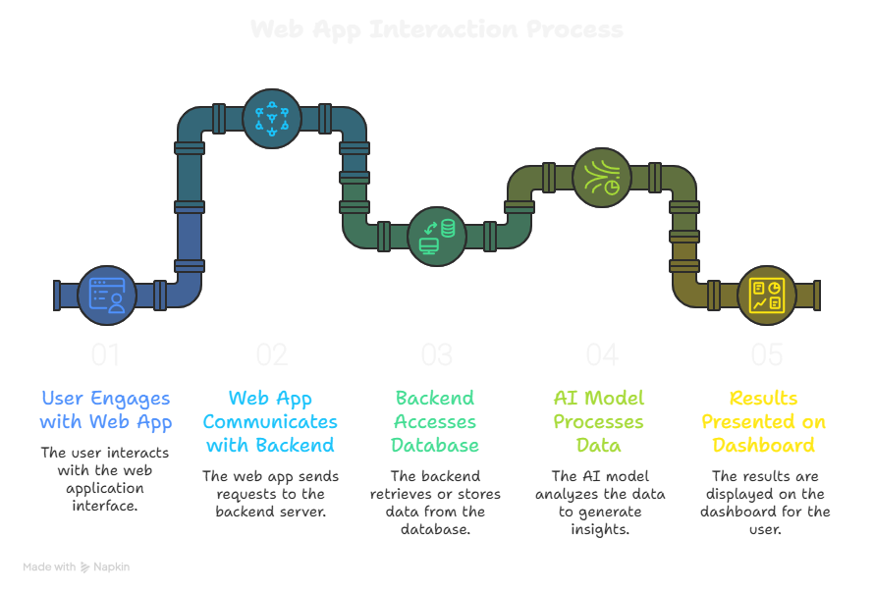
Modelling / Block Daigram
Notes:
Total duration: 5mins
Learning Objective: In this slide, the trainer will explain the students what they will learn and be able to apply in the real life situations.
Procedure: Discuss the above as the outcome of the session
Learning outcome: Students will understand the learning outcome in this slide.

Slide 8
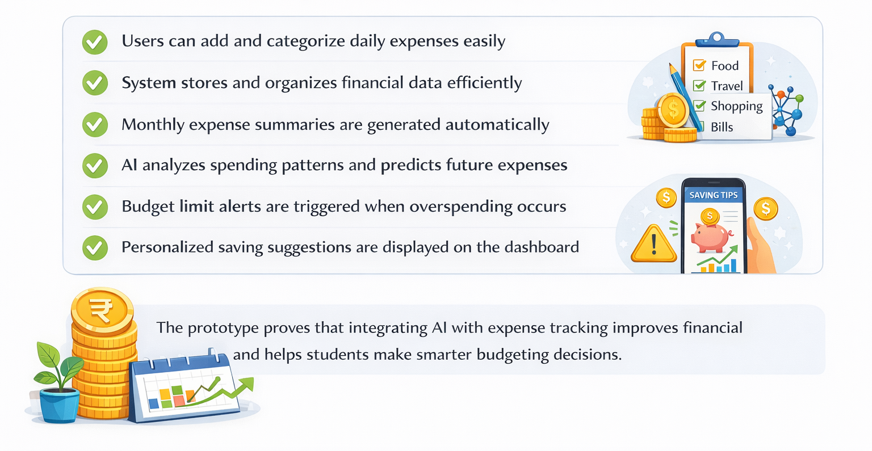
Result / Outcomes
Reduced overspending
Improved saving habits
Monthly financial analysis
Notes:
Total duration: 5mins
Learning Objective: In this slide, the trainer will explain the students what they will learn and be able to apply in the real life situations.
Procedure: Discuss the above as the outcome of the session
Learning outcome: Students will understand the learning outcome in this slide.

Slide 9
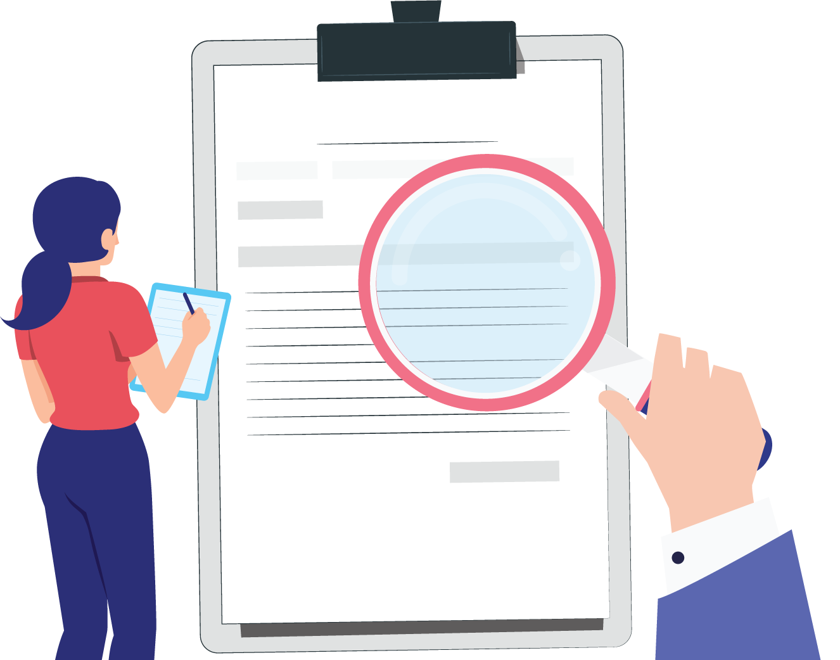
Conclusion
AI Smart Saving provides an intelligent financial management solution for students by integrating Artificial Intelligence and predictive analytics with expense tracking. The system not only records daily expenses but also analyzes spending patterns and predicts future financial trends.
Source
https://www.freepik.com/
Notes:
Slide duration: 5 min
Objective: To get clarity about the lesson is well received among students.
Procedure:
Ask: What did you learn from the lesson?
What is your takeaways from the lesson?
How this lesson is going to help you in your personal and professional life.
How are you going to implement this lesson?

Slide 10
Future Perspective
Mobile Application: Develop an Android and iOS mobile app for easier access and real-time expense tracking.
Bank Integration: Integrate the system with bank accounts or UPI services to automatically track transactions securely.
Investment Tracking: Add features to monitor small investments such as SIPs, mutual funds, or savings schemes to help students grow their money.
Smart Chatbot Advisor: Implement an AI-powered chatbot to provide instant financial advice, budgeting tips, and answers to user queries.
Notes:
Total duration: 5mins
Learning Objective: In this slide, the trainer will explain the students what they will learn and be able to apply in the real life situations.
Procedure: Discuss the above as the outcome of the session
Learning outcome: Students will understand the learning outcome in this slide.

Slide 11
Thank You
Notes:
Time: 25 to 30 Sec

